Slide 1
Saint Patrick's Day
SHYIN MAXIM, 8A

Slide 2
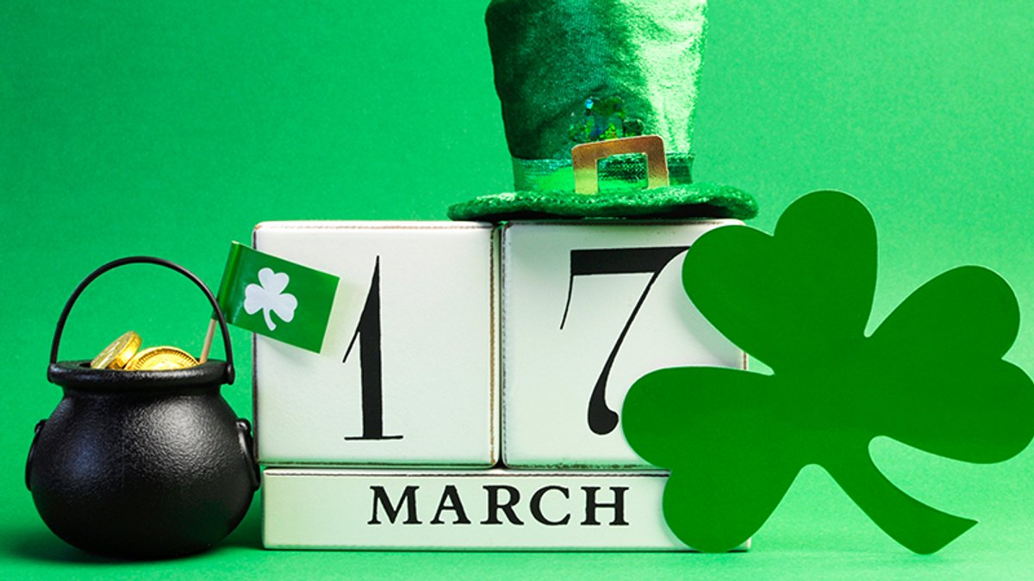
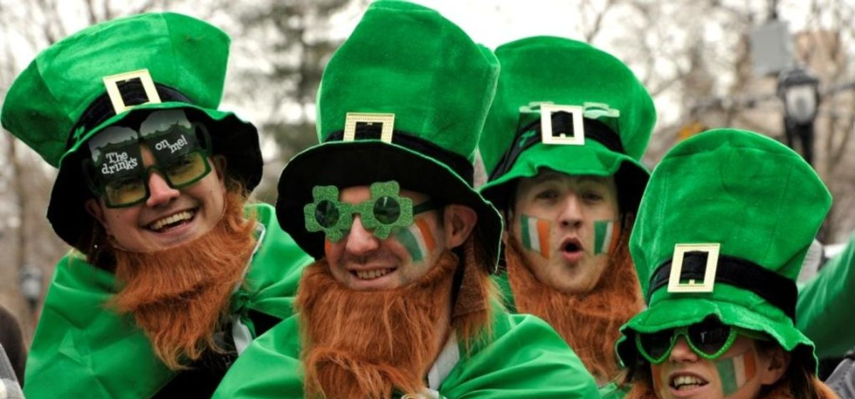
Short information about Saint Patrick's Day:
Saint Patrick's Day, or the Feast of Saint Patrick is a cultural and religious celebration held on 17 March, the traditional death date of Saint Patrick (c. 385 – c. 461), the foremost patron saint of Ireland. Saint Patrick's Day was made an official Christian feast day in the early 17th century and is observed by the Catholic Church, the Anglican Communion (especially the Church of Ireland), the Eastern Orthodox Church, and the Lutheran Church. The day commemorates Saint Patrick and the arrival of Christianity in Ireland, and celebrates the heritage and culture of the Irish in general. It is also widely celebrated in the United Kingdom, Canada, United States, Brazil, Argentina, Australia and New Zealand, especially amongst Irish diaspora.

Slide 3
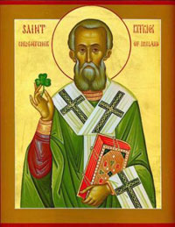
St Patrick's Day Story:
Saint Patrick, who lived during the fifth century, is the patron saint of Ireland and its national apostle. Born in Roman Britain, he was kidnapped and brought to Ireland as a slave at the age of 16. He later escaped, but returned to Ireland and was credited with bringing Christianity to its people. In the centuries following Patrick’s death (believed to have been on March 17, 461), the mythology surrounding his life became ever more ingrained in the Irish culture.

Slide 4
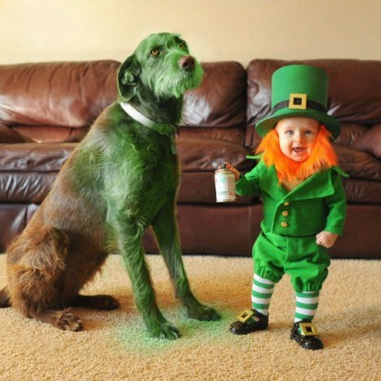
Traditions and customs of St Patrick's Day:
In the celebration of this day, Christian and pagan traditions are closely intertwined, despite the fact that Saint Patrick is remembered as a champion of the Christian faith. It is very difficult to separate one from the other, yes, and it is not necessary, since it is this interlacing that makes the holiday popularly loved. Some people annually plan a pilgrimage to St. Patrick's Purgatory, which is usually associated with repentance and spiritual healing since the early 13th century. It is located on Station Isle in the middle of Loch Derg in County Donegal, where Saint Patrick had a vision that promised that all who came to the sanctuary in repentance and faith would receive forgiveness for their sins.
One of the symbols of the holiday are leprechauns - fabulous shoemakers who own a hidden pot of gold. If a lucky treasure hunter manages to catch a leprechaun, then this creature must tell the person where his treasures are hidden. However, if you suddenly catch a shoemaker, then remember that you should not completely believe him - these little men are malicious and mischievous and can easily deceive a gullible treasure seeker.

Slide 5
The tradition of attaching a shamrock leaf, symbolizing a cross, to clothes goes deep into the times. There is a church hymn telling that Saint Patrick, using the shamrock, stopped the pagan ritual performed in the Irish royal capital of that time - Tara. Also, with the help of the shamrock, Patrick explained to the flock the meaning of the Holy Trinity - one of the main symbols of Christianity ("like three leaves growing from a single stem, God can be one in three persons").
Christian traditions include the annual ascent of pilgrims to the holy mountain "Croagh Patrick". According to legend, it was on this mountain that Saint Patrick performed one of his miracles - he expelled all the snakes. History says that while Saint Patrick was fasting, the snakes attacked him, so that he cast all the snakes into the ocean. However, it is believed that there have not been any snakes in Ireland since the last Ice Age. The "serpents" that Saint Patrick expelled from Ireland may include the Druids or pagan worshipers of snakes or serpent gods.
The tradition of drinking at least one glass of alcohol in some Irish bar belongs to the folk tradition. There is a so-called "Patrick's Cup" - a unit of measure for drinking whiskey. Belief prescribes to put a leaf of clover in a glass before drinking a glass of whiskey. The people say so - "we will drain the shamrock". Interestingly, in Ireland itself, St. Patrick's Day has long been considered an exclusively religious holiday, and until the seventies of the last century, Irish laws prohibited pubs from working on March 17!

Slide 6
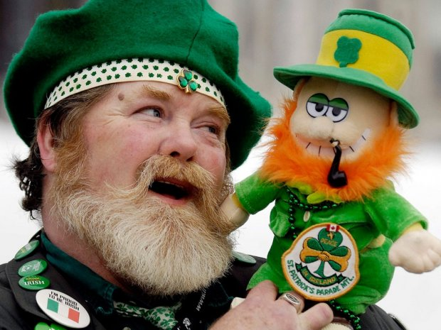
Saint Patrick's Day in Ukraine 2021
Despite difficult quarantine times, residents of the capital will gather again to celebrate St. Patrick's Day with a traditional parade. Participants are encouraged to wear something green, take Irish flags, friends and good humor. You can also take musical instruments with you for even more fun. The St. Patrick's Day parade will take place along the route: st. Vladimirskaya - Sofiyskaya Square, with the entrance to the Historical Museum - Andreevsky Descent - Kontraktova Square. The organizers ask the parade participants not to forget about quarantine - to wear masks and maintain social distance.
When: March 20,
15:00. Where: Shevchenko Park.
How much: Free.

Slide 7
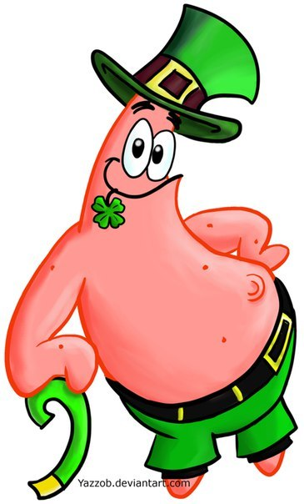
THE END!

