Slide 1
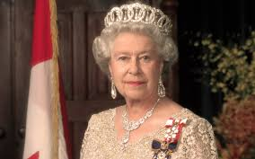
Queen Elizabeth ІІ

Slide 2
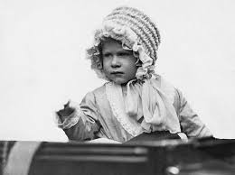
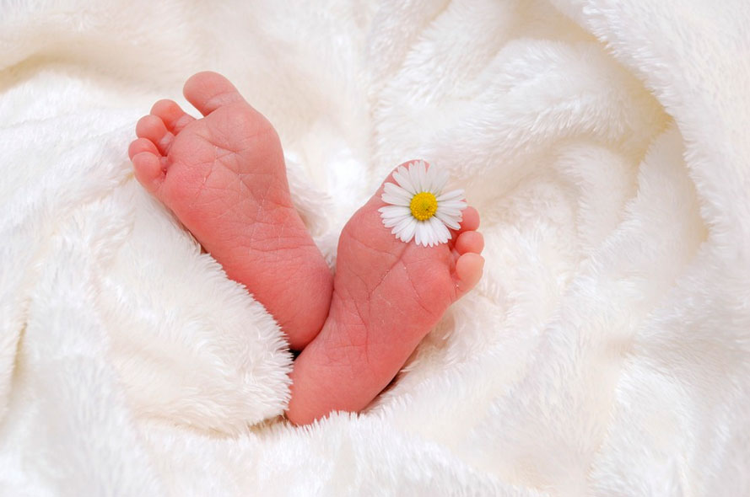
.
Elizabeth was born on 17 Bretton Street, London, April 21, 1926, to Prince Albert, Duke of York, and Duchess of York.

Slide 3
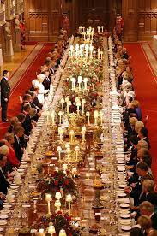
The birthday of Elizabeth II “according to the passport” is April 21 and this is the real birthday of the queen. She celebrates him in a quiet family circle at Windsor Castle. No hype, no pathos: family dinner

Slide 4
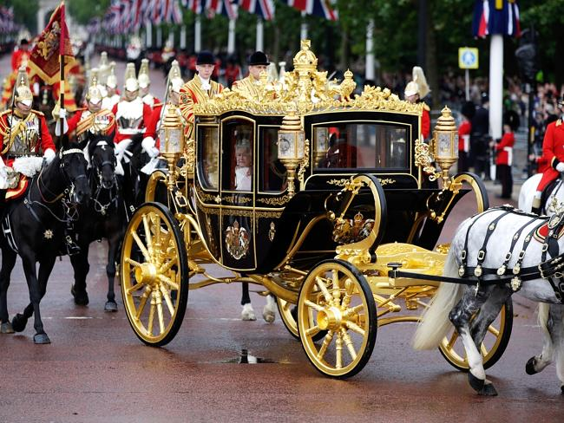
It is customary to celebrate the second, or official, birthday pompously, on a grand scale, with fireworks and parades, usually in the summer

Slide 5
