Slide 1
LONDON EYE
5 – A class

Slide 2
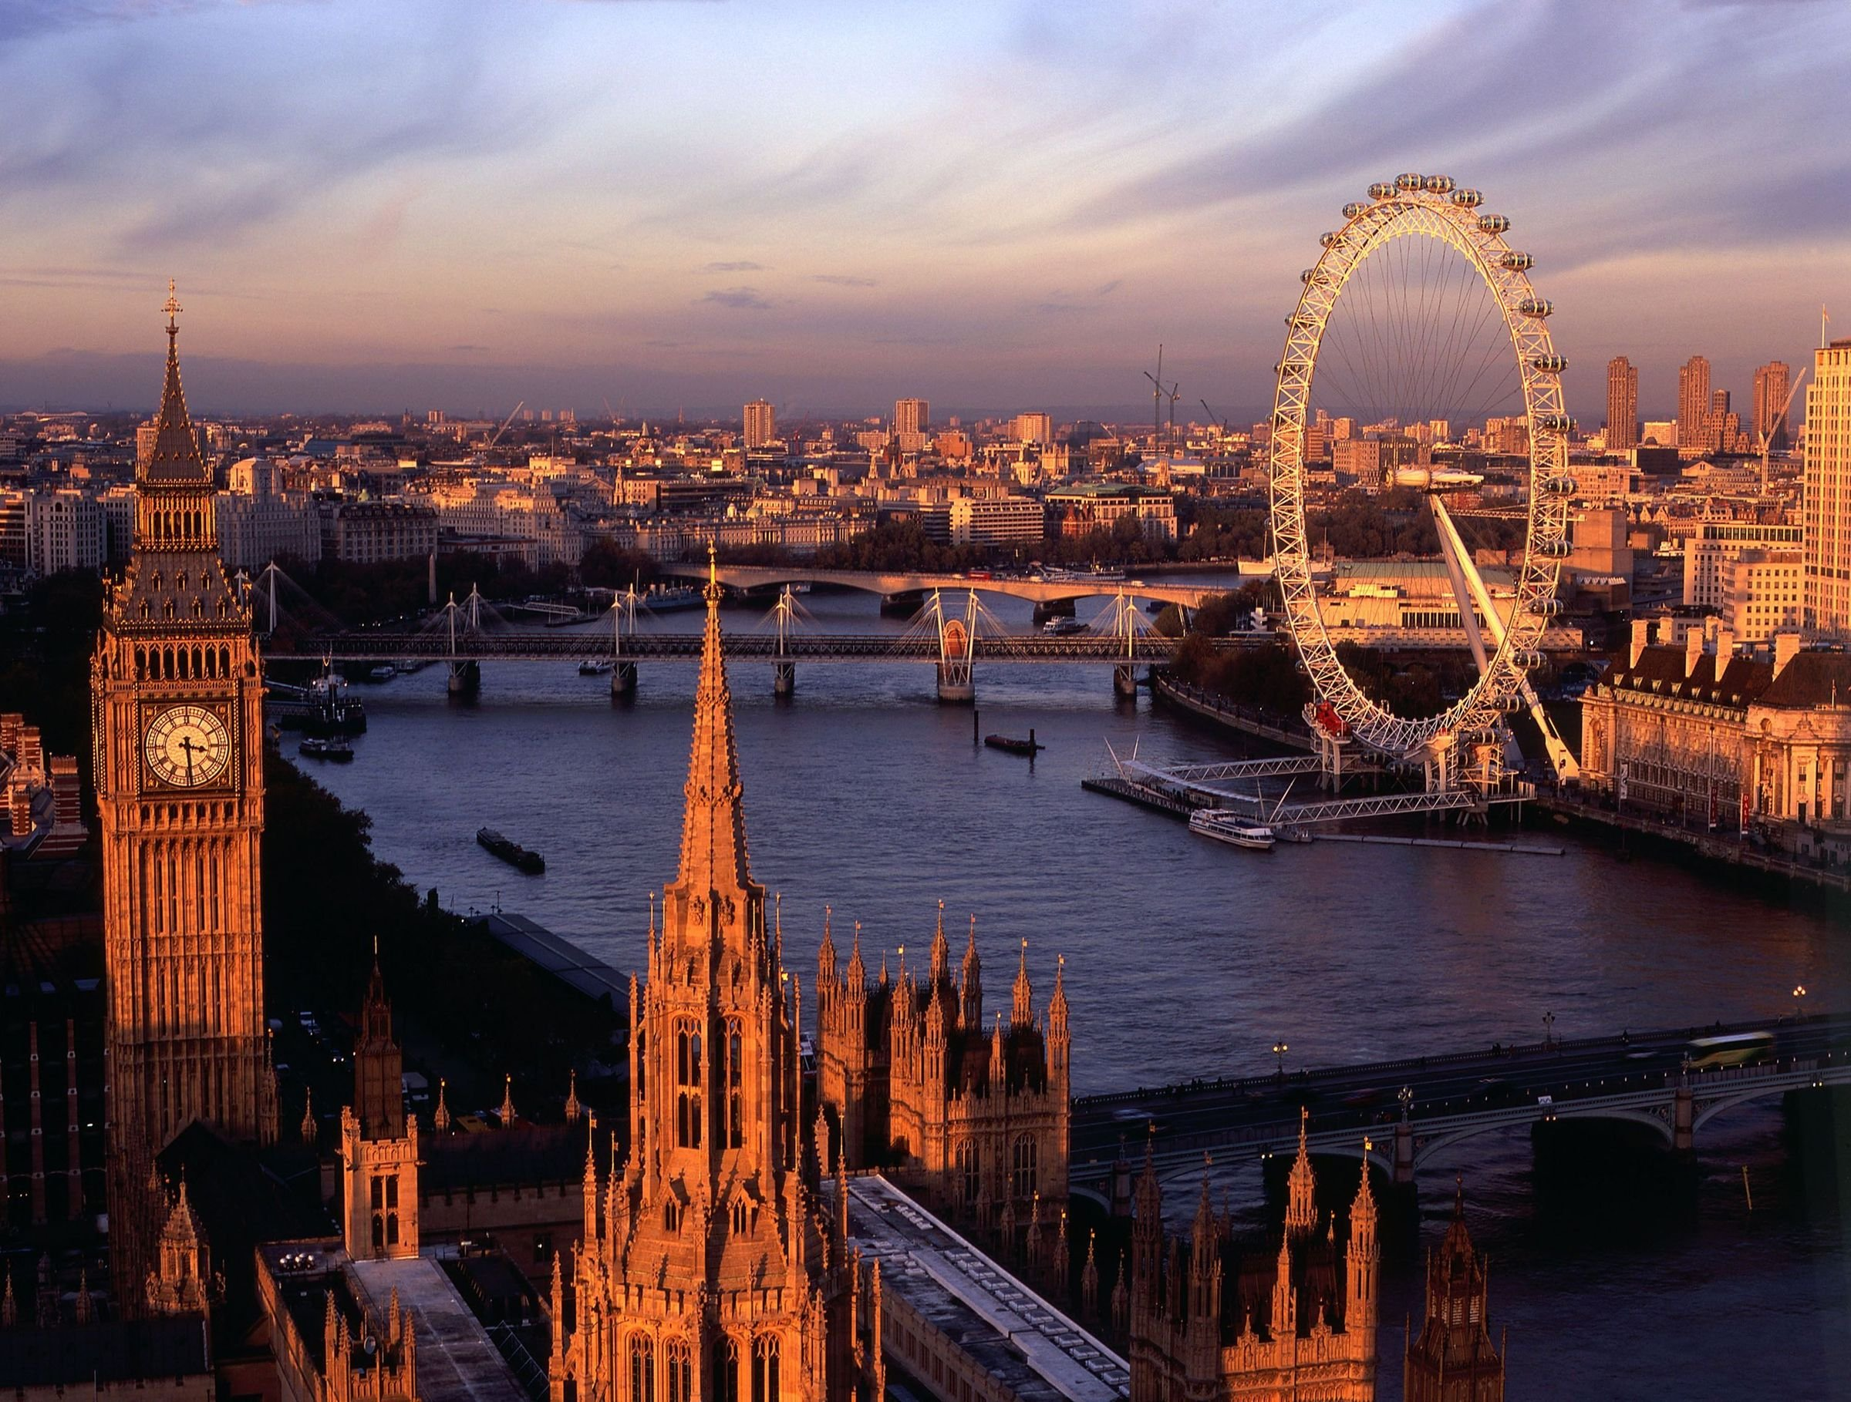
The London Eye is the London's most popular paid for attraction with nearly 4 million people going on it each year and has won over 85 awards for national and international tourism,
outstanding
architectural quality
and engineering
achievement.

Slide 3
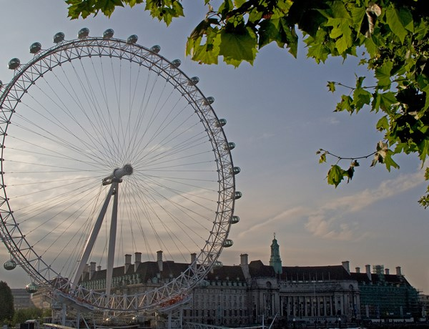
The London Eye stands on the South Bank of the River Thames in London, between Westminster and Hungerford Bridges. It is the world's highest observation wheel.

Slide 4
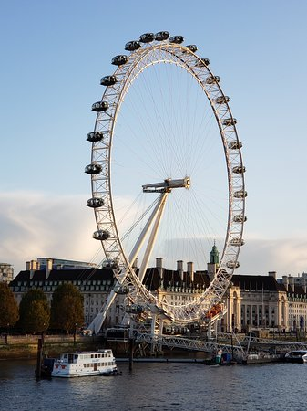
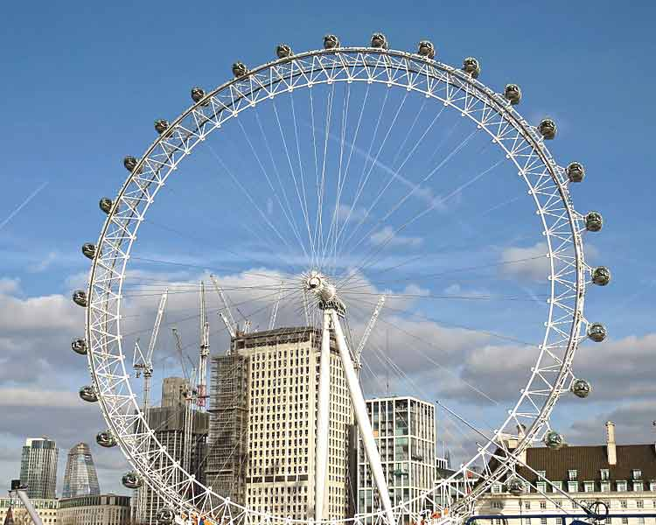
The total weight of steel in the Eye is
1,700 tonnes .

Slide 5
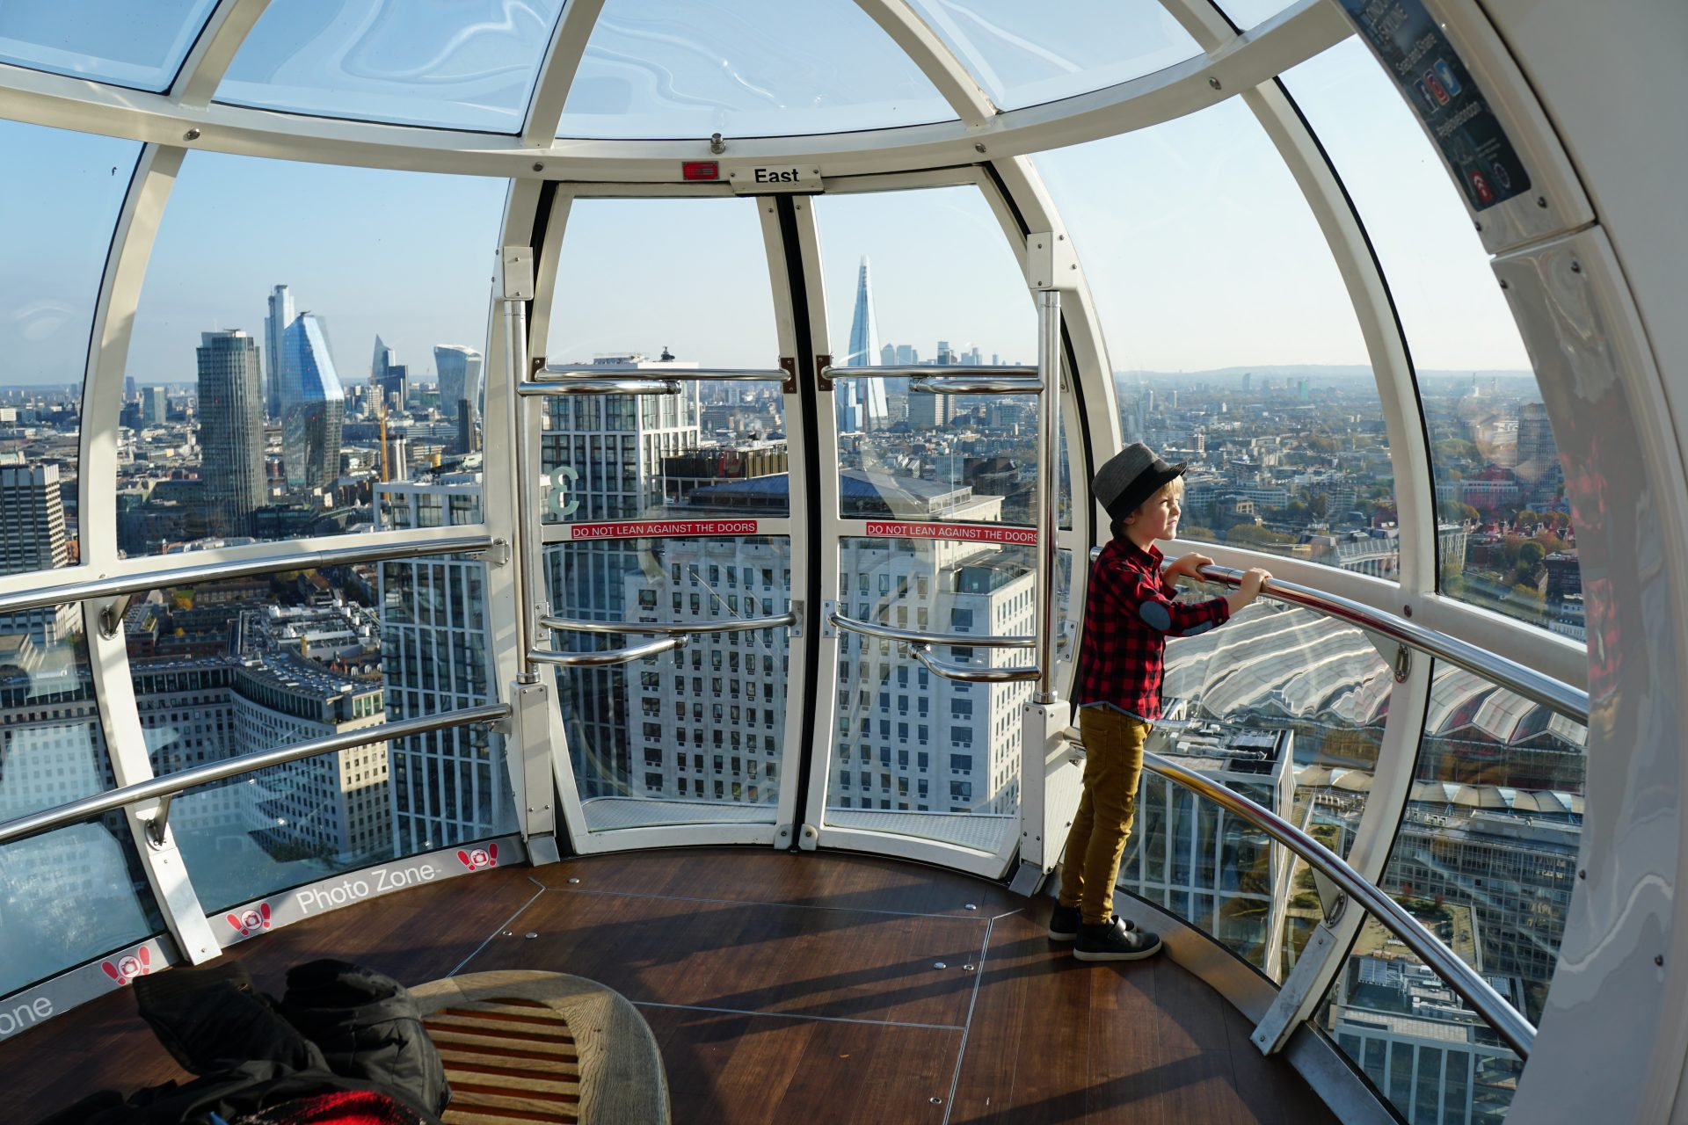
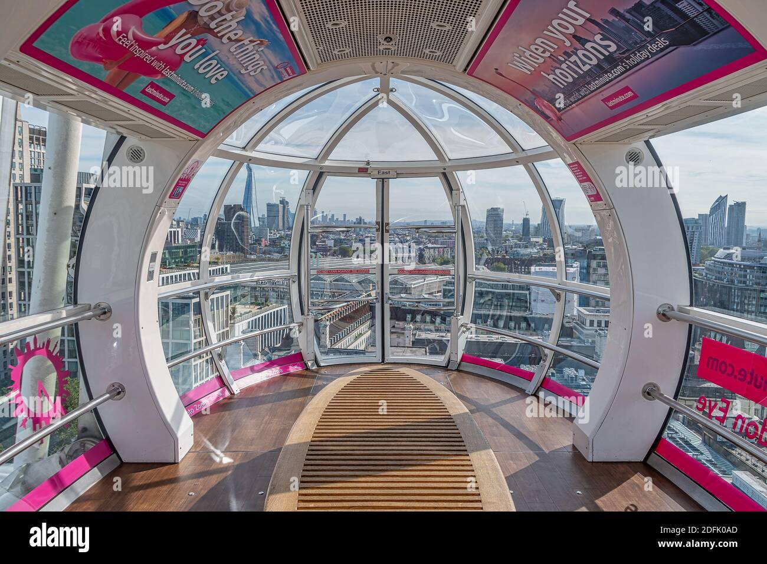
The view from the cabines is amazing:

Slide 6
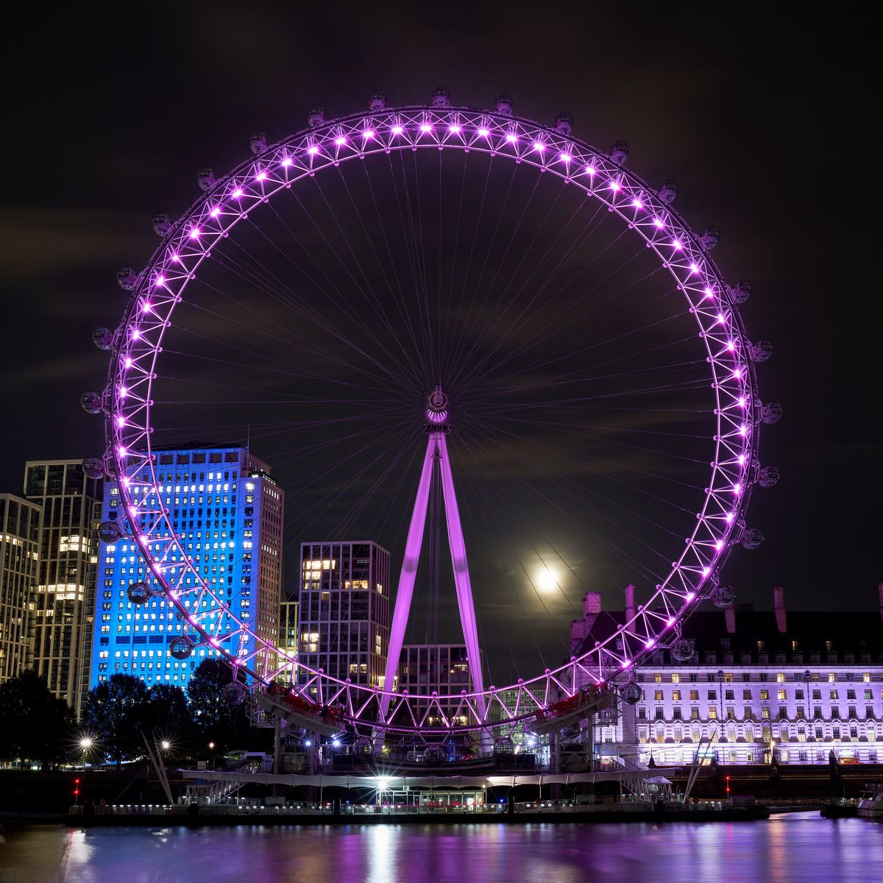
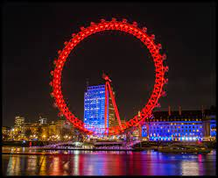
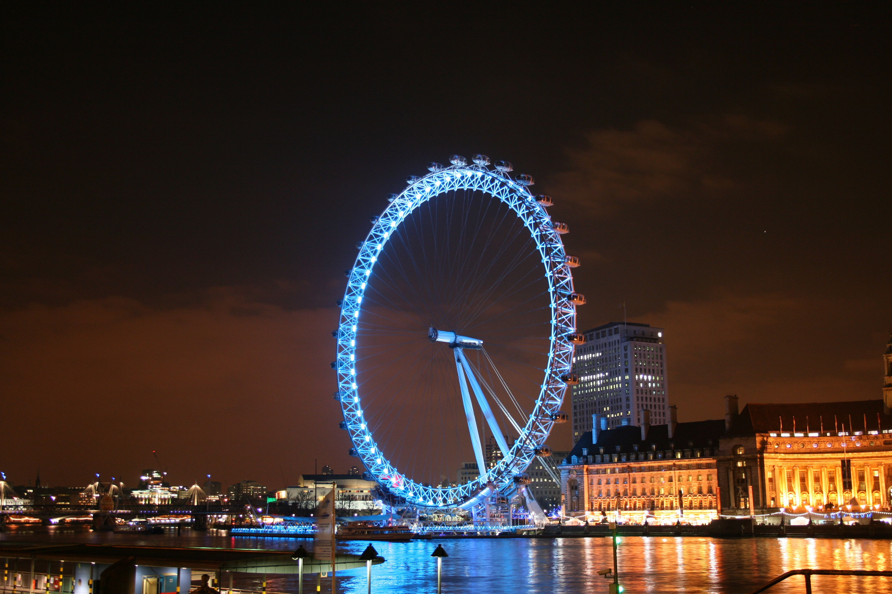
It is illuminated every night and has several different colours that are used for different days and events.

Slide 7
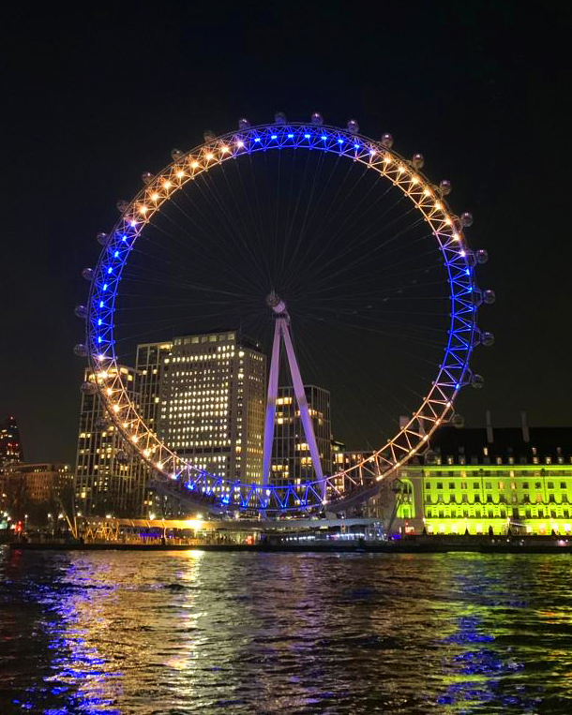
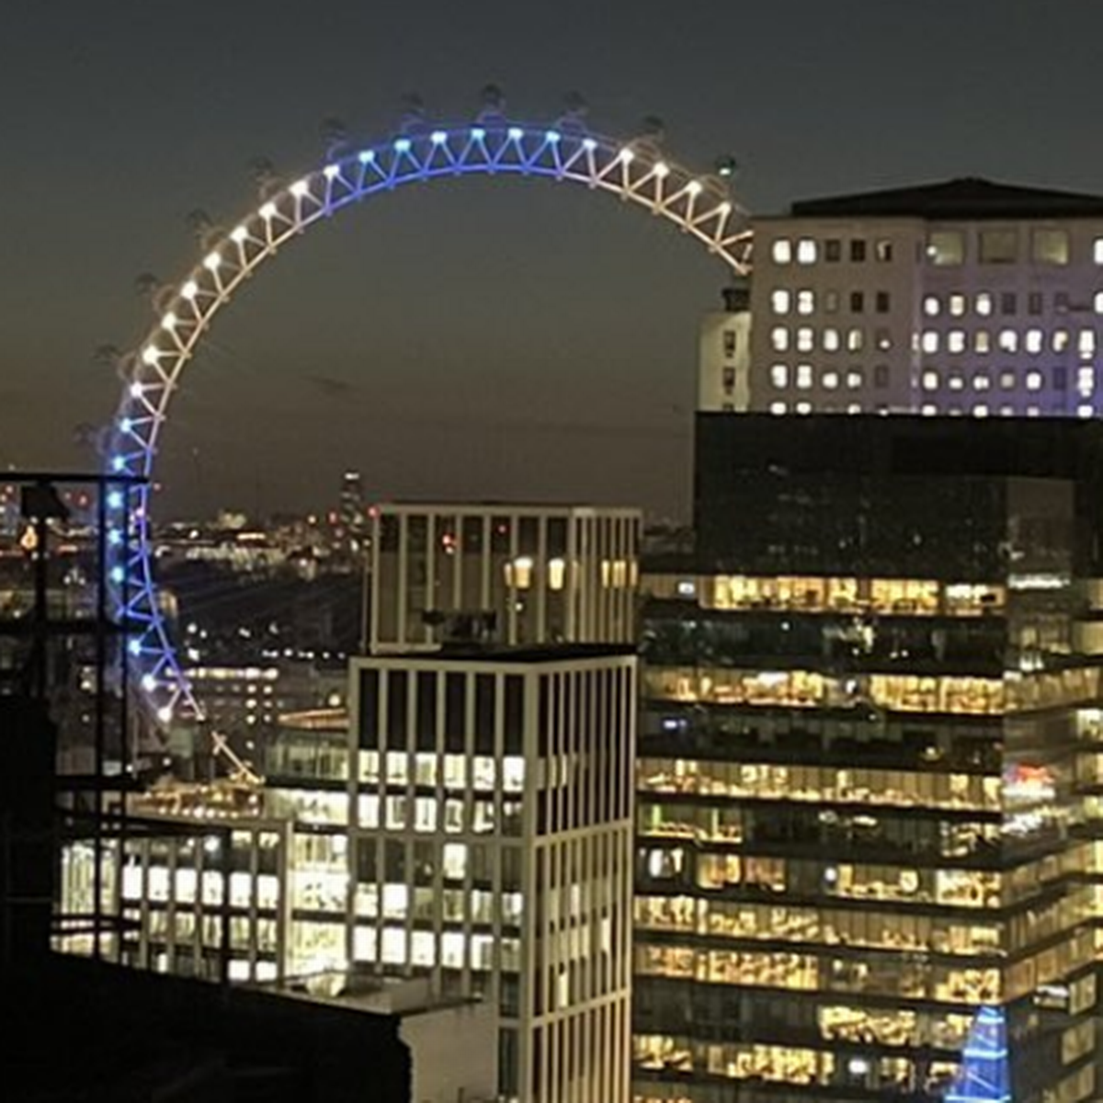
The London Eye was brightly lit up in blue and yellow to show solidarity with Ukrainians and Ukraine on 25th of February.

Slide 8

Thanks for your attention!

