Slide 1
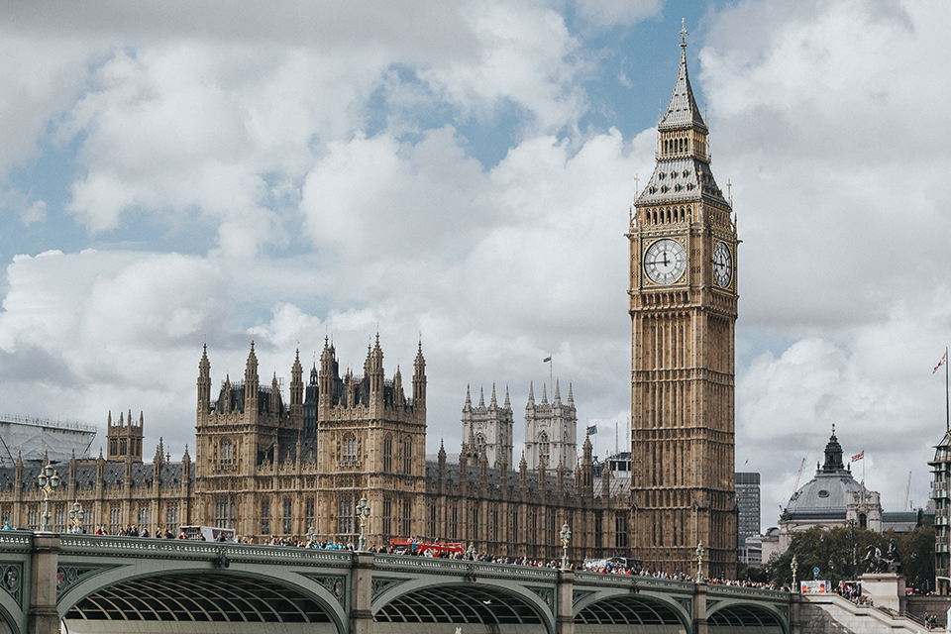
England

Slide 2
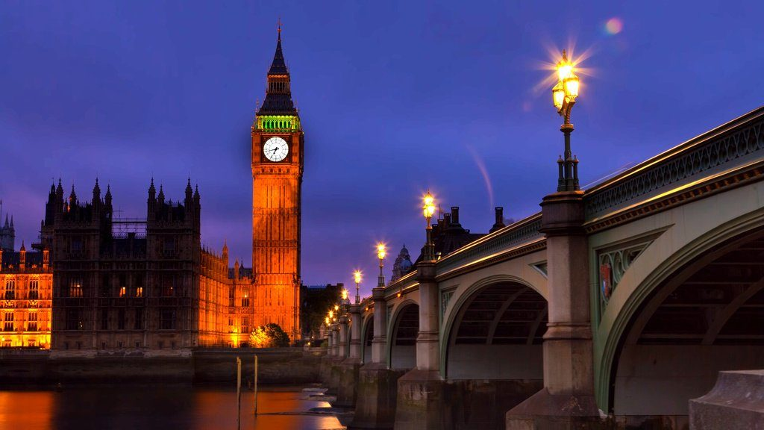
What is England?
England is a country in Western Europe, part of the United Kingdom of Great Britain and Northern Ireland. The largest in area and population of the four countries of the United Kingdom and three parts of the United Kingdom.

Slide 3
About the world-famous "English tea party"

Slide 4
Rules and traditions of tea party
English tea is not just a tea snack. Over the years, this tradition has acquired its own rules and etiquette, which must be followed during tea party. First there is the preparation for tea party:
Put a small table in the living room and cover it with a white tablecloth. Also place flowers, tea utensils and utensils on the table
Guests can choose from several different types of tea (preferably 5 to 1).
Tea is also prepared in a special way:
1. First, heat the kettle with a little boiling water.
2. Then pour the tea into the kettle and pour boiling water.
3. Let the tea brew for a few minutes, meanwhile pour the milk into a cup.
4.And only now add tea to the cup.

Slide 5

Interesting facts about England:
England does not cover the entire territory of Europe's largest island - Britain, but only two-thirds.
Until 1362, the official language of England was French.
The British invented not only football, but also shoelaces.
The Queen of England does not take any part in governing the country, but only symbolizes the power of the Constitutional Monarchy.
The largest river in England - the Thames, has a length of over 300 km. Every year, on the last day of summer, rubber duck competitions are held here.
22 white swans living on the Thames, as well as noble fish species in all waters of England belong to the Queen.

Slide 6
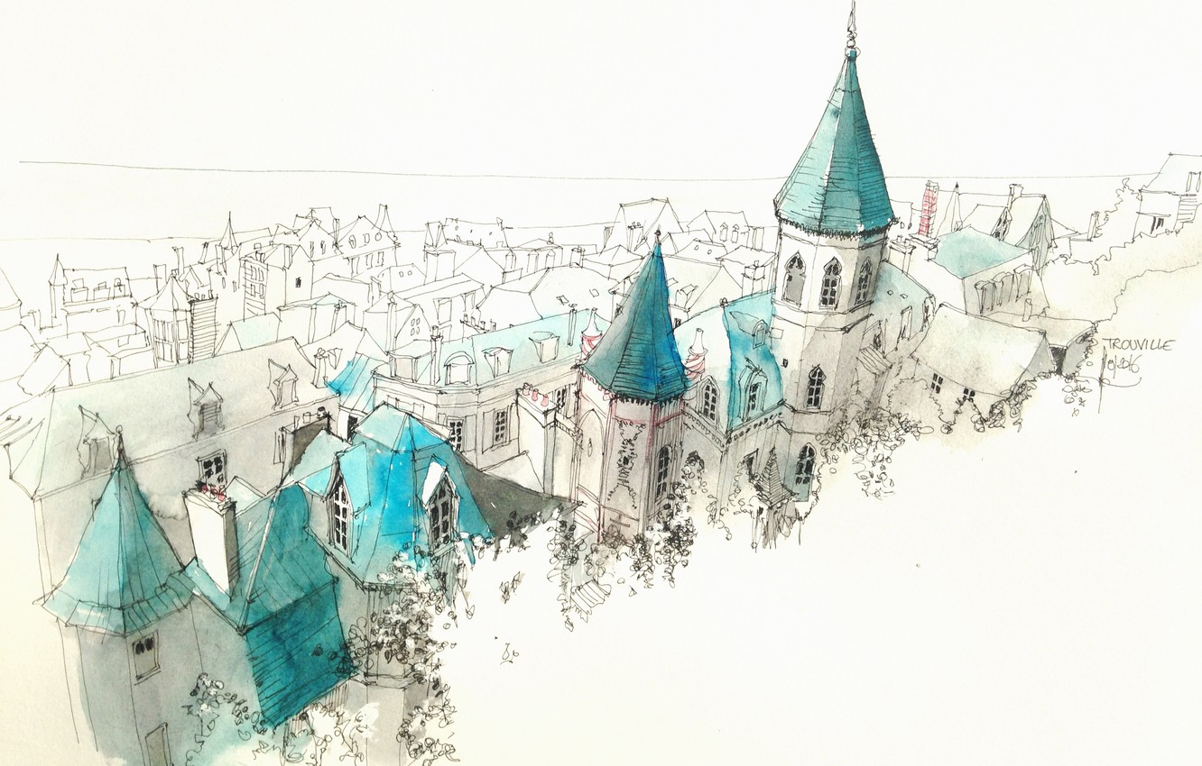
Thanks for watching ♡
I hope you learned something new for yourself!

